Slide 1



Practical
WEB DEVELOPMENT
Github.com/aldamr01
Aldion Amirrul
Linkedin.com/aldionamirrul
@Squidward_Tenpoles

Slide 2

Our Agenda
Introduction to Programming
What is web development ?
Basic web development language
Commonly used language
The environment
Common stacks

Slide 3





Informatic Engineering Student at UNTAG from 2016 – 2020
Community Organizer at Surabaya.py from 2020 – Now
Backend Developer at Nusanet Surabaya from 2019 - 2021
Software Engineer at Avia Avian from 2021 – Now

Slide 4
PROGRAMMING
Programming is the process of creating a set of instructions that tell a computer how to perform a task. Programming can be done using a variety of computer programming languages, such as JavaScript, Python, and C++.
-Pamela Fox (UC Berkeley CS Lecture)

Slide 5
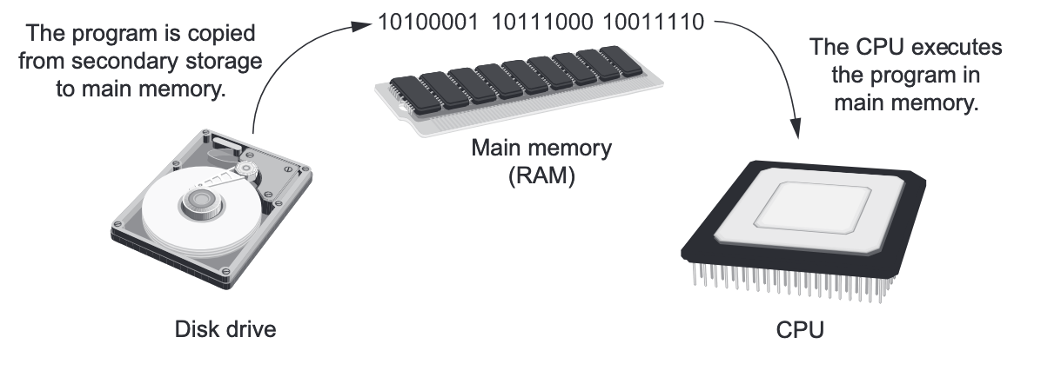
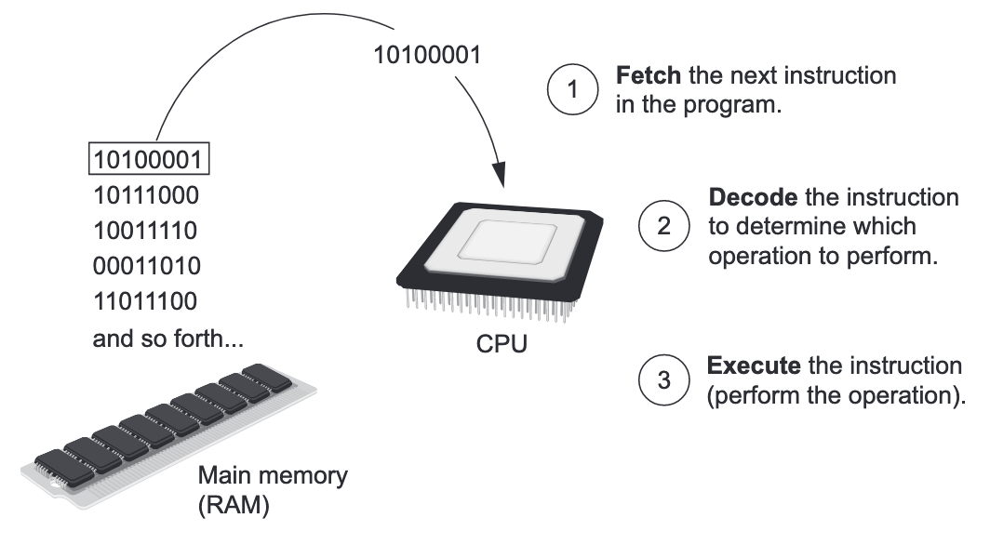
How Program work

Slide 6
2 Technique to make your program can be executed by a computer
Because the CPU understands only machine language instructions, programs that are written in a high-level language must be translated into machine language. Depending on the language that a program has been written in, the programmer will use either a compiler or an interpreter to make the translation.
Compiler
A compiler is a program that translates a high-level language program into a separate machine language program.
Interpreter
Interpreter is a program that both translates the language to machine language instructions and executes them.
Notes:
Because the CPU understands only machine language instructions, programs that are writ- ten in a high-level language must be translated into machine language. Depending on the language that a program has been written in, the programmer will use either a compiler or an interpreter to make the translation.

Slide 7
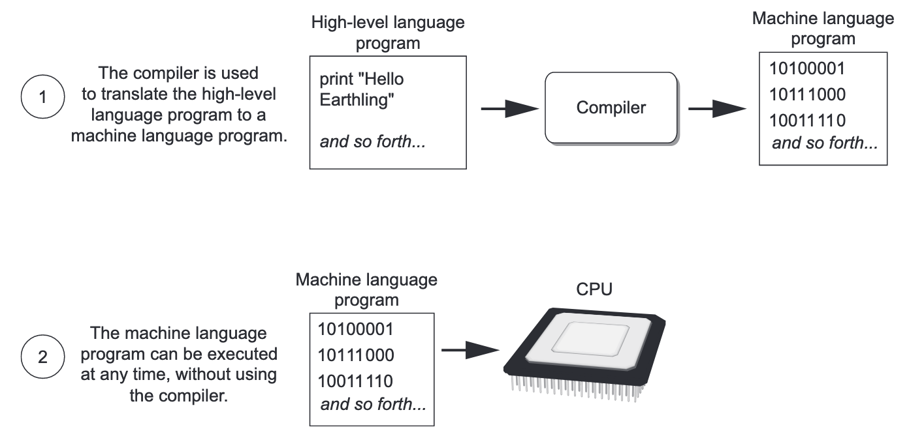
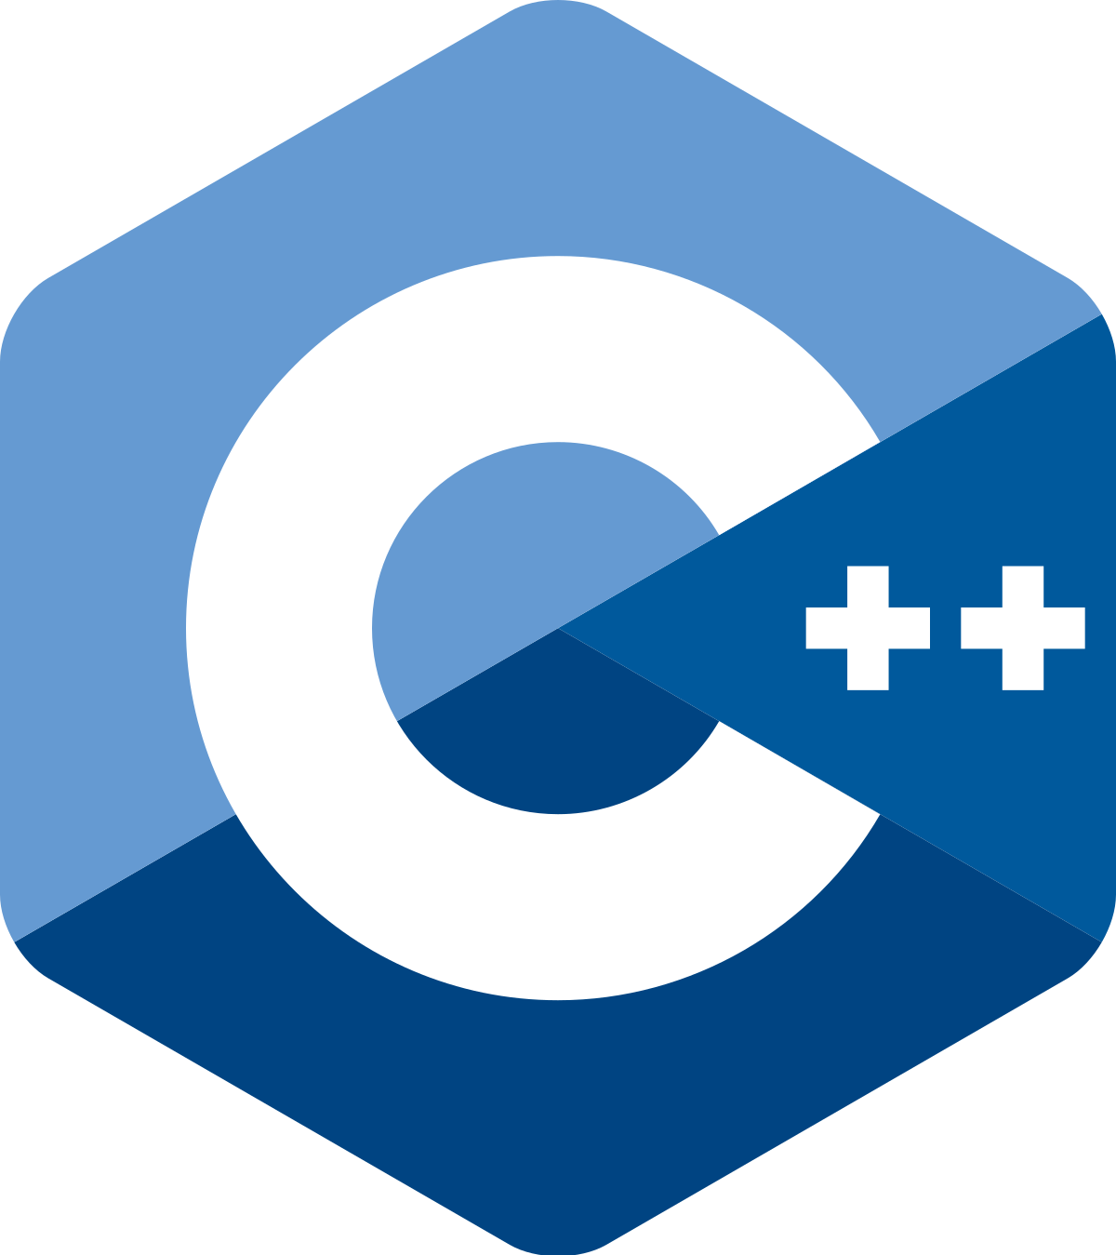




Compiler
The languages :

Slide 8
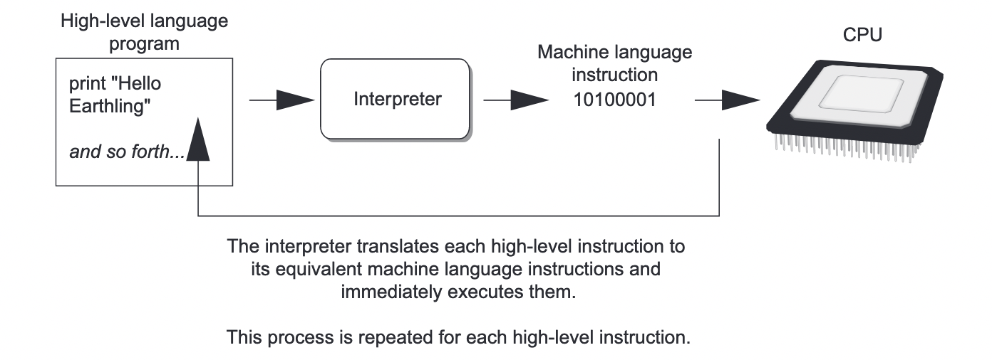




Intepreter
The languages :

Slide 9
What is Web Development
Web development refers to the building, creating, and maintaining of websites. It includes aspects such as web design, web publishing, web programming, and database management. It is the creation of an application that works over the internet i.e. websites.
And Web Developer refers to the person who building, creating, and maintaining of websites. The role of web developer is variant, commonly is Front-End developer and Back-End developer.

Slide 10
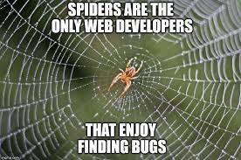
FUN FACT

Slide 11


Basic web development language

Slide 12
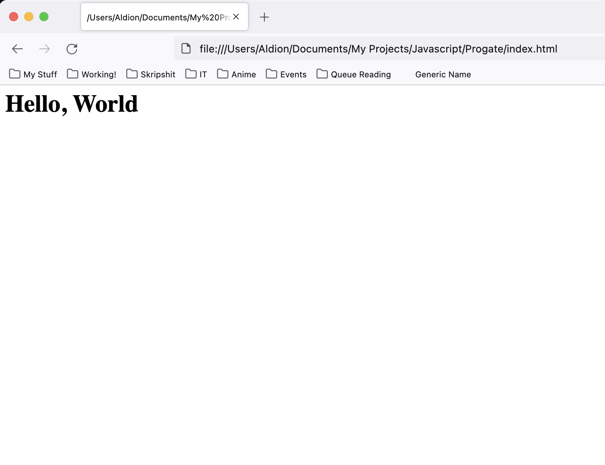
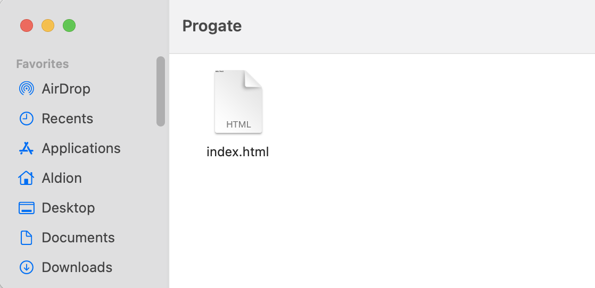
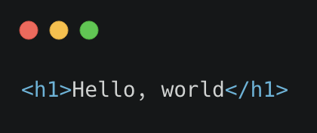
Hypertext Markup Language (HTML)
HTML, short for Hypertext Markup Language is the name of that language. Hypertext is text that contains hyperlinks, which in turn are those parts of a document which readers can click on to take them to a different document, using the link. You have all seen the blue underlined parts of a text, in not-so-good-looking web pages. These are hyperlinks.
A document in HTML consists of tags, with text in between them. There are opening and closing tags for example, as follows:

Slide 13
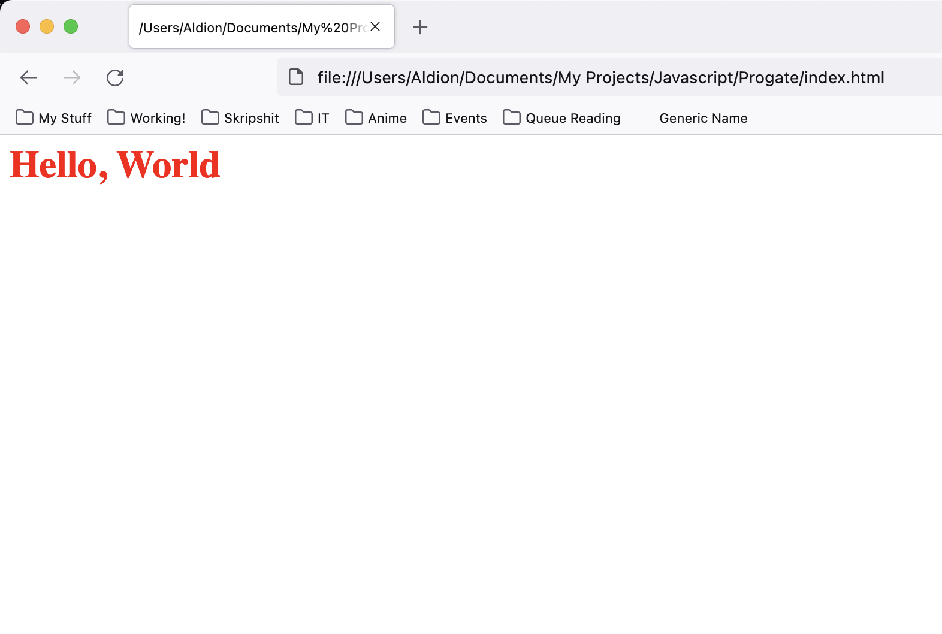
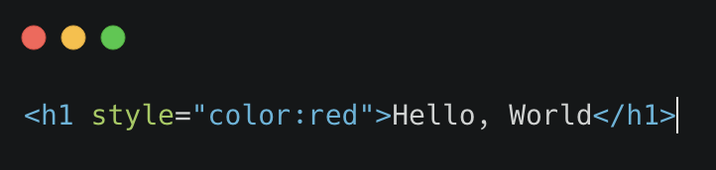
Cascading Style Sheets (CSS)
CSS (Cascading Style Sheets), is the language that used to style and lay out web pages — for example, to alter the font, color, size, and spacing of your content, split it into multiple columns, or add animations and other decorative features.

Slide 14
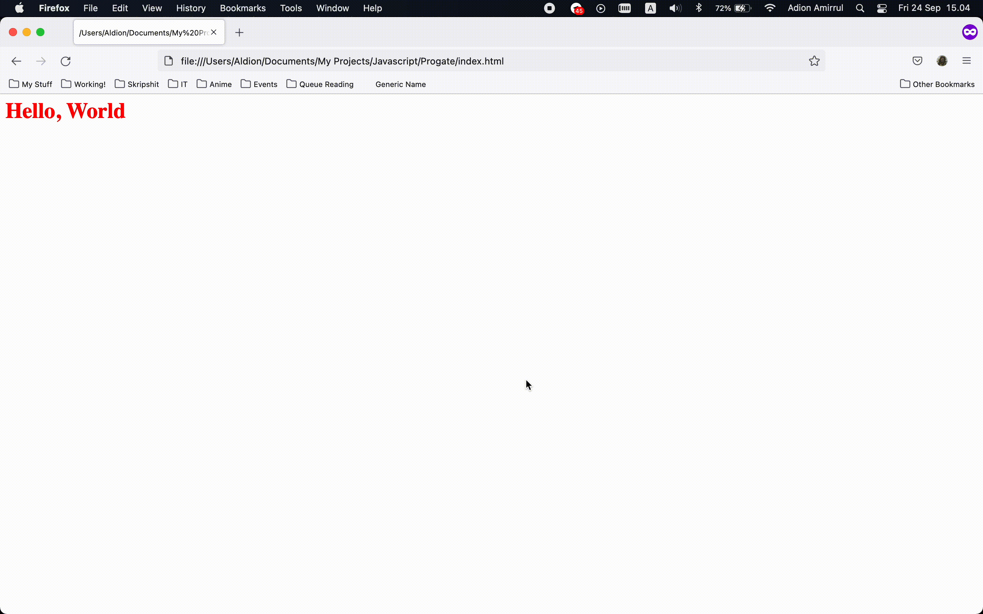
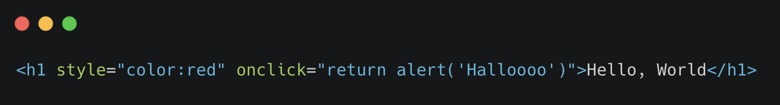
Javascript (JS)
JavaScript is a scripting or programming language that allows you to implement complex features on web pages. Every time a web page does more than just sit there and display static information for you to look at , such as displaying timely content updates, interactive content, animated 2D/3D graphics, realtime graphic stats, etc.

Slide 15
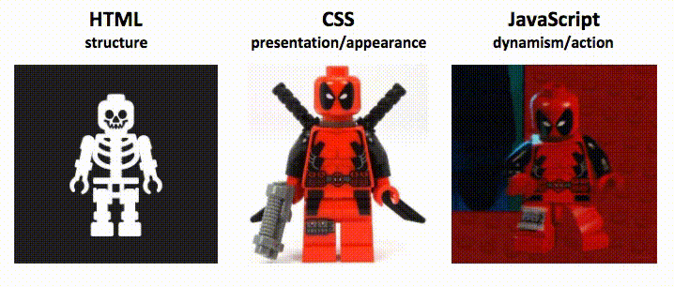
So.. This is HTML, JS, CSS looks like

Slide 16
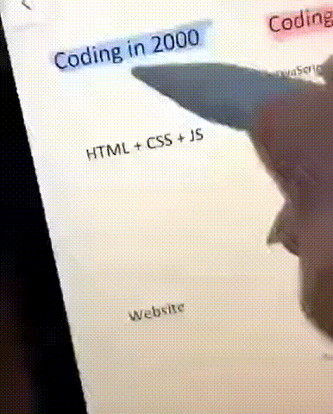
Coding in 2000 vs Coding in 2020

Slide 17





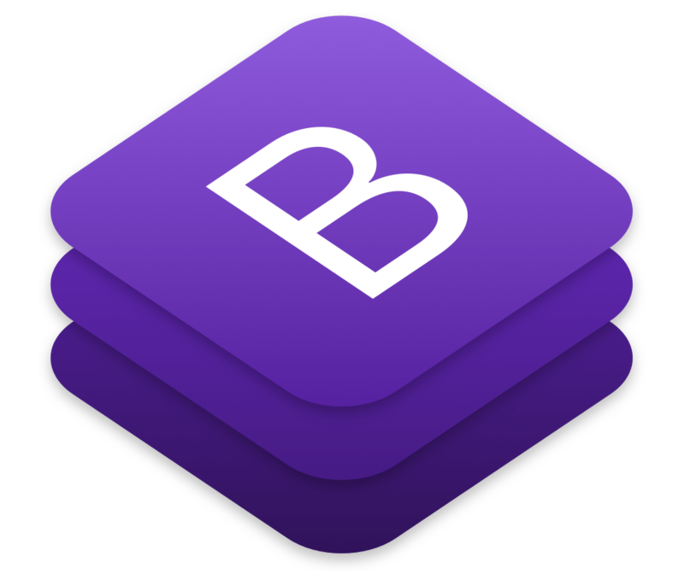


Commonly used language/frameworks

Slide 18










The Environment
The platform/program that helps you to write a bunch of code for creating or developing an application.
Text editor
IDE

Slide 19
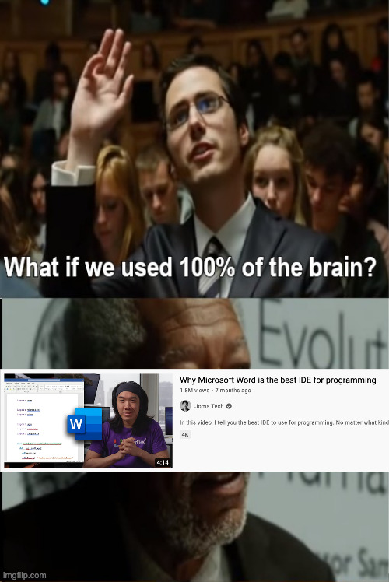
So.. I'll tell you again one more time! , please choose wisely your environment !

Slide 20

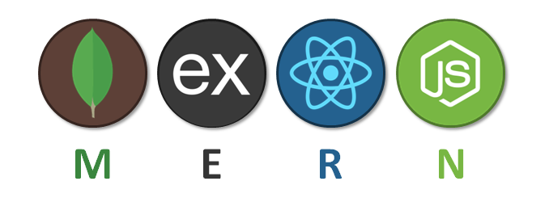
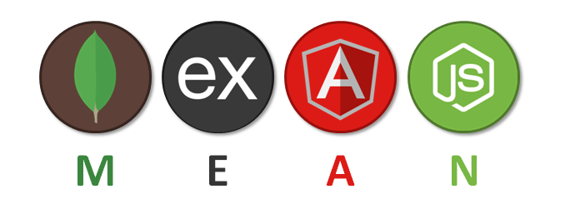
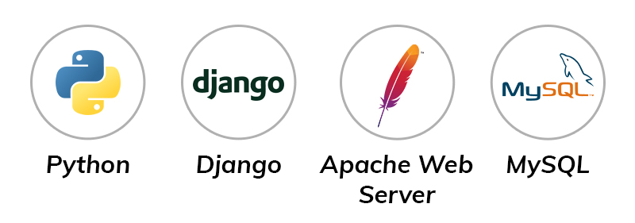
Common Stacks

Slide 21

Any Questions ?
Here.. the Answer from the most Frequently Asked Questions

Slide 22
Slide references
Practical Web Development by Paul Wellens.
Introduction to Computers and Programming, Pearson’s Slides.
https://www.freecodecamp.org/news/compiled-versus-interpreted-languages/
https://www.geeksforgeeks.org/web-development/
https://developer.mozilla.org/en-US/docs/Learn/CSS
https://www.khanacademy.org/computing/computer-programming/programming/intro-to-programming/v/programming-intro
https://developer.mozilla.org/en-US/docs/Learn/JavaScript/First_steps/What_is_JavaScript

